Slide 1
Introduction to Data Information System
Presentation By: Chetan Raikwar
Faculty IIPS-DAVV, Indore

Slide 2
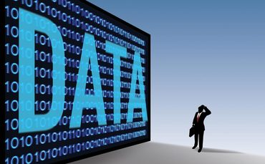

The Concept of

Slide 3
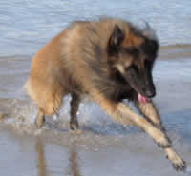
Data
Raw facts and/or observation from which useful information is derived
A collection of facts, such as values or measurements
It can be numbers, words, measurements, observations or even just descriptions of things
It may be qualitative and/or quantitative
Qualitative:
He is brown and black
He has long hair
He has lots of energy
Quantitative:
Discrete:
He has 4 legs
He has 2 eye
Continuous:
He weighs 25.5 kg
He is 565 mm tall

Slide 4
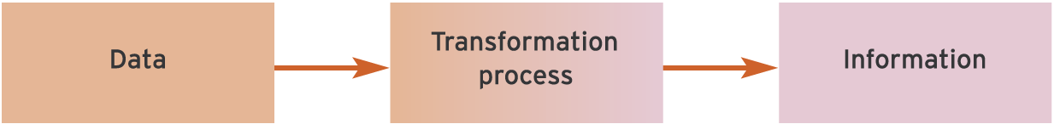
Information
“Data that has been processed into a form that is meaningful to the recipient and is of real or perceived value in current or prospective actions of decision”
Gordon Davis and Margrethe Olson
Features of Information
It reduced uncertainty
It has value in decision making
It is reusable
It has surprise element or news value

Slide 5
Data Versus Information
Monthly Sales Report
for West Region
1200 100
West Aryan
4444 TM Shoes
Sales Rep: Aryan
Emp No. 4444
Item Qty Sold Price
TM Shoes 1200 Rs100

Slide 6
Attributes of Information Quality

Slide 7
Time Related Attributes
Timeliness:
Information should be available when needed.
Currency:
The information should be up-to-date when needed.
Frequency:
The information should be available as frequently as needed.
Time Period:
The time period may be past, present and future as needed by the user.

Slide 8
Content Related Attributes
Accuracy:
The information should be free from errors.
Relevance:
The information should be specific to the needs of the recipient.
Completeness:
All the information required must be provided to the user when needed.
Brevity:
Information needed must be provided in the right measure. Too much information may confuse the recipient.

Slide 9
Form Related
Clarity: The form in which information is served must be easy to understand.
Detail: The level of summary or detail as required by the user must be met.
Order: There should be a predetermined order for providing information.
Presentation: The presentation may be in narrative, numeric or graphic form, etc.
Media: The media may be paper documents, video displays, etc. as needed by the user.

Slide 10
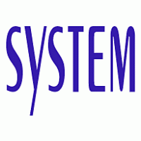

Slide 11
System
The term system is derived from a Greek word SYSTEMA which means organized relationship between component
A system is designed to achieve one or more objective.
According to System Theory “System means developing a systematic, theoretical framework upon which decision can be made”.
A system is an orderly grouping of independent component linked together according to a plan to achieve a specific objective.

Slide 12
Characteristics of System
Organization
Interaction
Integration
Interdependence
Central Objective

Slide 13
Feedback
Inputs:
Material
Capital
Equipment
People
Information
Energy
Outputs:
Goods (Tangible)
Service (Intangible)
Customer
Supplier
Process
System
Value Driven Concept of System

Slide 14
Elements of System
Input & Output
Processor
Control
Feedback
Environment
Boundaries and Interface

Slide 15
Inputs
Conversion Sub-system
Outputs
Environment
Legal/Political
Social, Economic
Technological
Physical
Locational Services
Exchange Services
Storage Services
Government Services
Other Private Services
Market
Competition
Product Information
Customer Desire
Goods or
Services
Primary Resources
Materials & Suppliers
Capital Assets
Personnel
Utilities
Capital (Money)
Feedback
Information
Control Sub System
A System Model

Slide 16
Types of System
Conceptual and Empirical
Open and Closed System
Natural and Artificial System
Social and Machine System

Slide 17
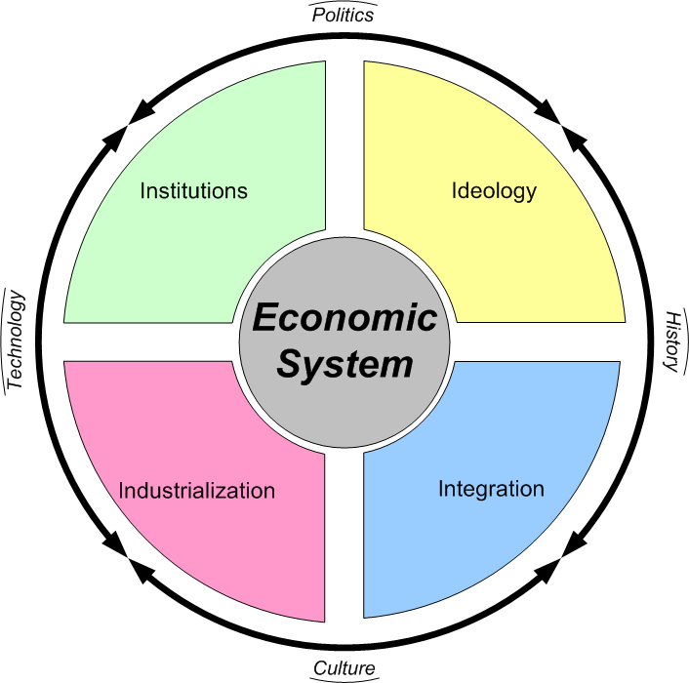
Conceptual System: Conceptual system is a theoretical framework which may or may not have any counter part with real world.

Slide 18
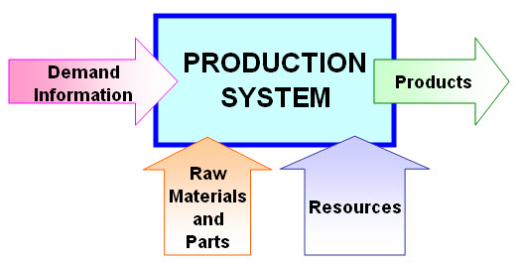
Empirical systems may be derived from or based upon conceptual systems.

Slide 19
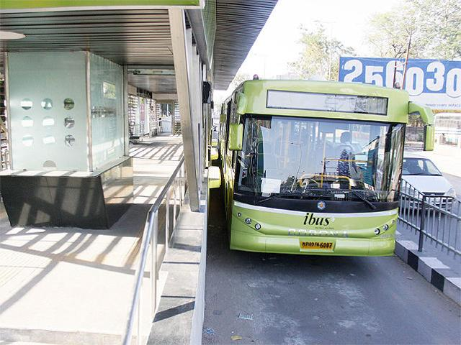
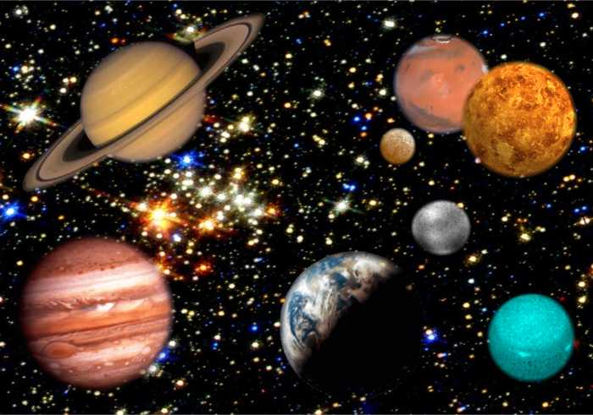
Natural and Artificial Systems

Slide 20
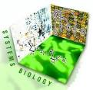
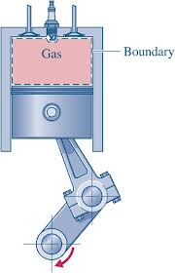
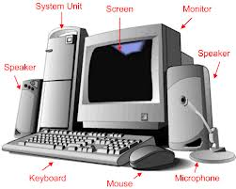
Open and Closed Systems

Slide 21
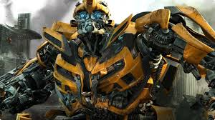

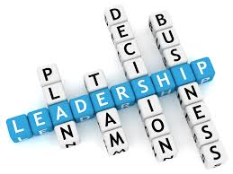
Social and Machine Systems

